Slide 1
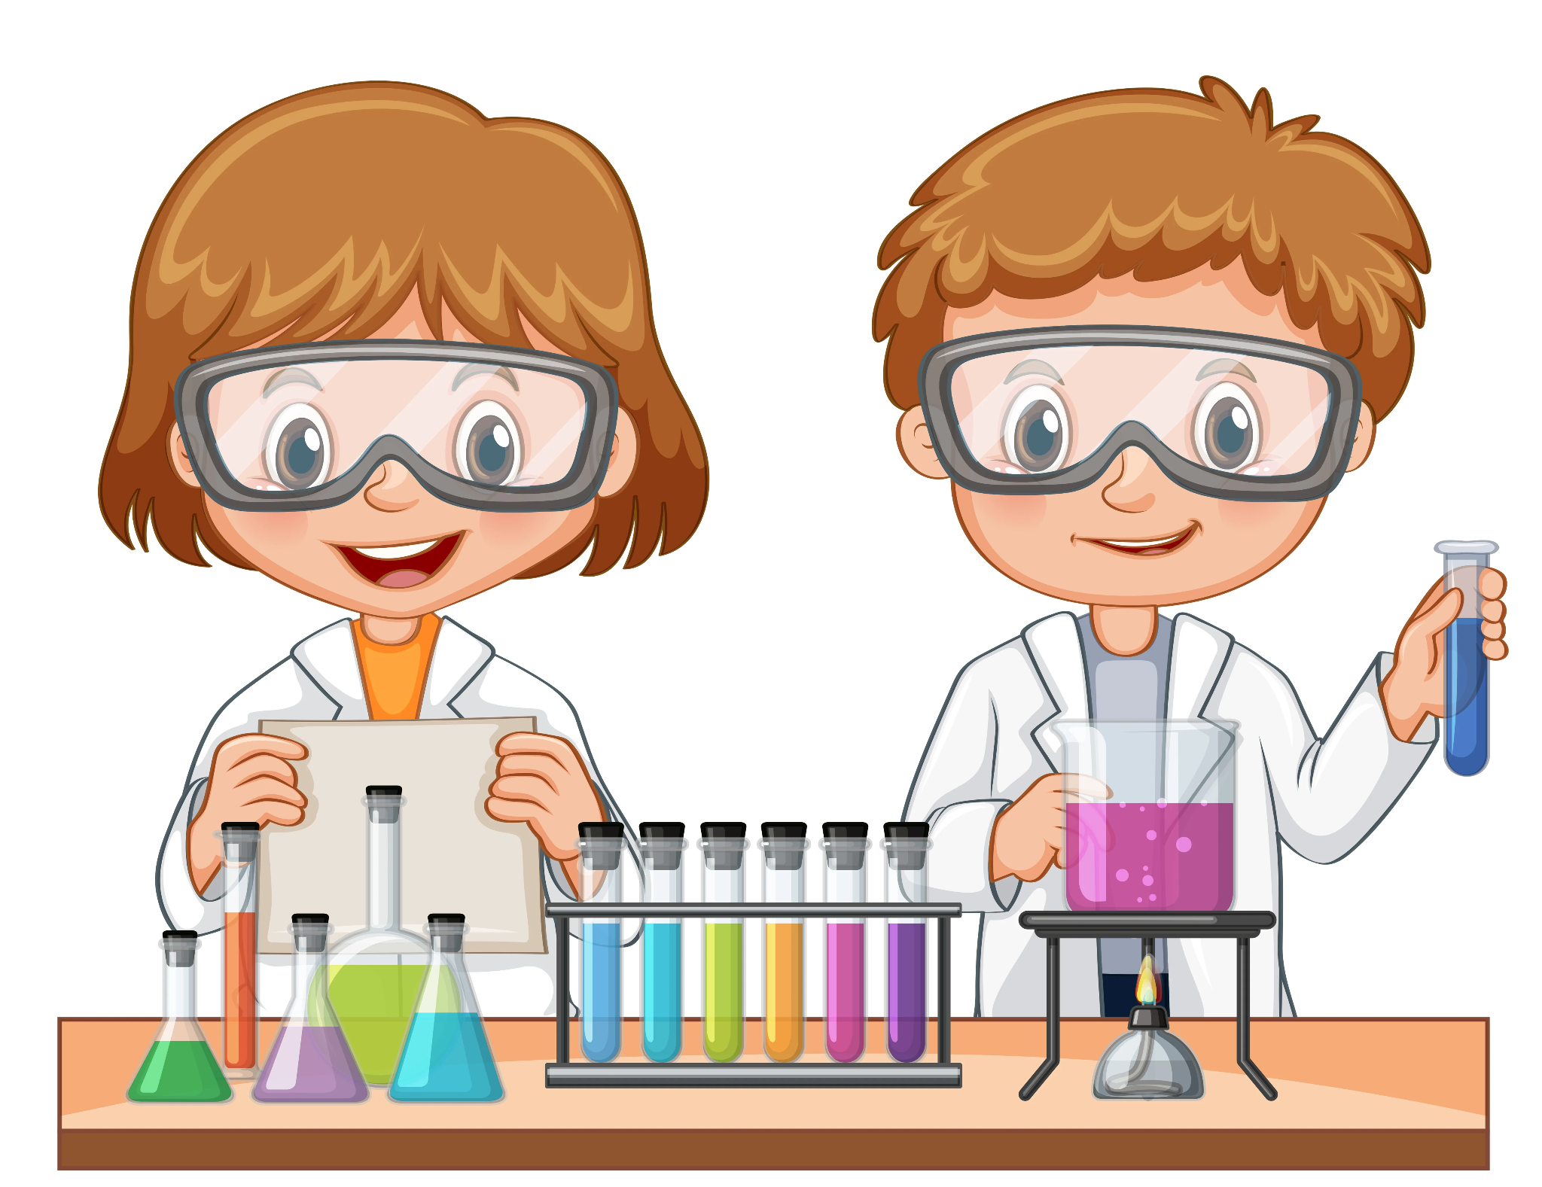
KS3 SCIENCE CURRICULUM MAP
Y9 AP2 Assessment
Y9 AP3 Assessment
Plants
PERIODIC TABLE
ENERGY
Ecosystems and respiration
Earth's atmosphere and metals
WAVES AND ASTRONOMY
Transpiration
Translocation
Photosynthesis
Structure of leaf
Atomic structure
Elements
Periodic table
Electron configurations
Energy stores and transfers
Efficiency
Resource
Food chains
Biodiversity
Biological cycles
Pollution
Reactions with metals
Today's atmosphere
Recycling
Describing waves
Wave speeds
Refraction
Reflection
Astronomy
MOTION AND FORCES
Y9 AP1 Assessment
Y8 AP3 Assessment
Vectors and scalars
Acceleration
Newton's laws
Momentum
Crash hazards
SEPARATING TECHNIQUES
CELLS AND ENZYMES
INVESTIGATIONS
THE EARTH
ECOSYSTEMS
States of matter
Mixtures
Filtration
Distillation
Cell structure
Bacterial cells
Enzymes
Food tests
Full investigations
The atmosphere
Sedimentary rocks
Igneous rocks
Metamorphic rocks
Rock cycle
Carbon cycle
Photosynthesis
Leaves
Plant minerals
Chemosynthesis
Respiration
Food webs
5&6
Y8 AP2 Assessment
MOTION AND PRESSURE
HEALTH AND LIFESTYLE
ENERGY
SEPARATING TECHNIQUES
ADAPTATIONS AND INHERITANCE
ACIDS AND METALS
ELECTRICITY AND MAGNETISM
Speed
Motion graphs
Pressure in gases.liquids/ solids
Turning forces
Nutrients
Food tests
Digestive system
Drugs
Alcohol
Smoking
Food and fuels
Temperature
Energy transfer
Energy resources
Mixtures
Solutions
Solubility
Metals
Metal displacement
Ceramics
Polymers
Competition
Variation
Natural selection
Circuits
Resistance
Magnetism
PERIODIC TABLE
Y8 AP1 Assessment
Y7 AP3 Assessment
Metals and non metals
Groups and periods
Elements of groups 1, 7, 0.
SKILLS
SPACE
CHEMICAL REACTIONS
REPRODUCTION
SOUND
Designing experiments
Hazards and risks
Conclusions
Evaluations
Solar system
Earth
Moon
The night sky
Word equations
Burning fuels
Conservation of mass
Adolescence
Reproductive systems
Development of fetus
Waves
Sound and energy
Loudness and pitch
Detecting sound
Ultrasound
CELLS
ATOMS, ELEMENTS, COMPOUNDS
LIGHT
BODY SYSTEMS
ACIDS AND ALKALIS
Plant and animal cells.
Observing cells
Movement of substances
Unicellular organisms.
Light
Reflection
Refraction
The eye
Colour
Levels organisation
Breathing
Skeleton
Muscles
Acids and alkalis
pH and indicators
Neutralisation
Making salts
Elements
Compounds
Atoms
Y7 AP2 Assessment
FORCES
Y7 AP1 Assessment
Students follow the Activate KS3 Scheme of Learning.
Types forces
Squashing and stretching
Drag and friction
Balanced and unbalanced forces
Non contact forces.
PARTICLES AND THEIR BEHAVIOUR
SCIENCE SKILLS
States of matter
Particle model
Changes state
Gas pressure
Using a bunsen burner safely.
Variables.
Hazards and risks.
Graphs and conclusion.
Notes:
I have added a few helpful shapes and terms if you would find these useful for your own CM. Delete from the outer page if not needed. You can easily change the colours by clicking on the shape you want to change, going to ‘shape fill’ and picking a colour. The white lines can be moved to allow for more or less space.

